Slide 1
Hybrid_Diff_Pipeline_No_Removal
t
e
x
t

Slide 2
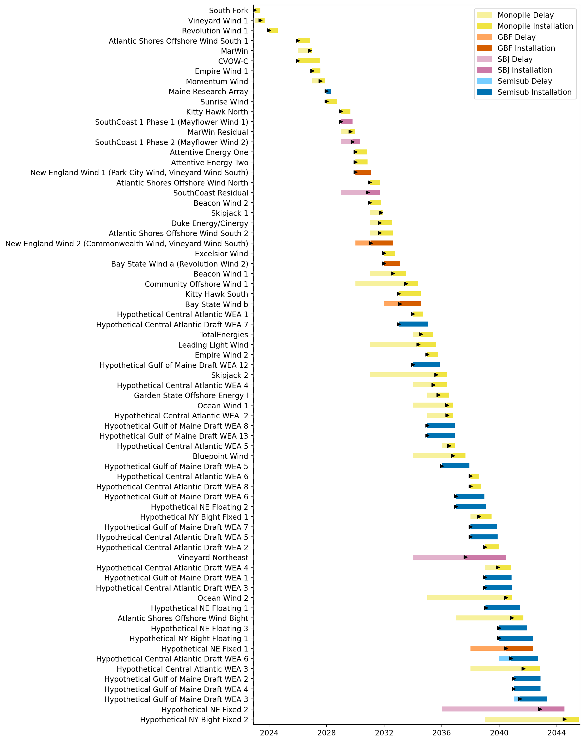
Full Gantt

Slide 3
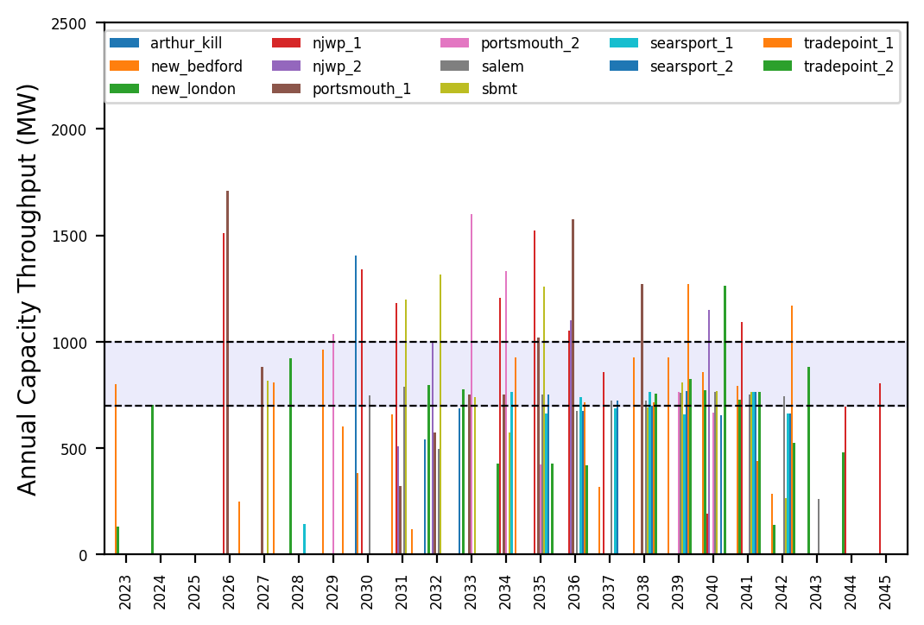
Port Throughput

Slide 4
10_Feeders_No_Foreign_WTIVs
t
e
x
t

Slide 5
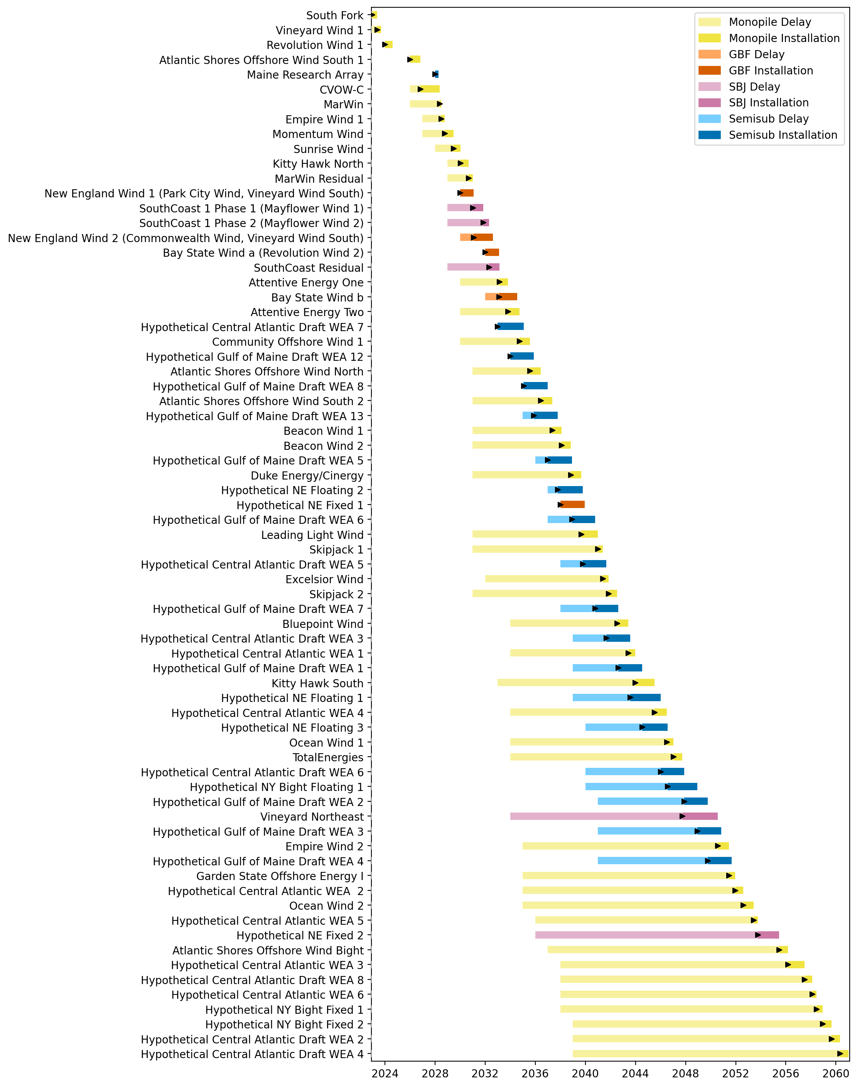
Full Gantt

Slide 6
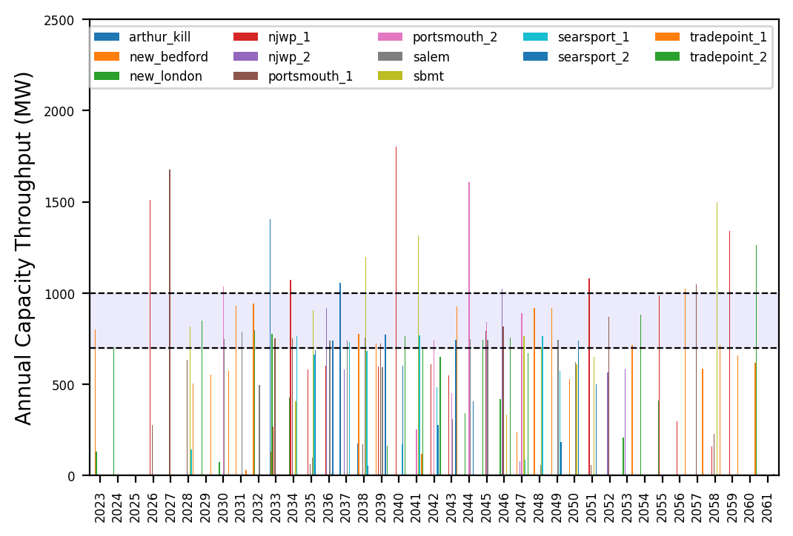
Port Throughput

Slide 7
10_Feeders
t
e
x
t

Slide 8
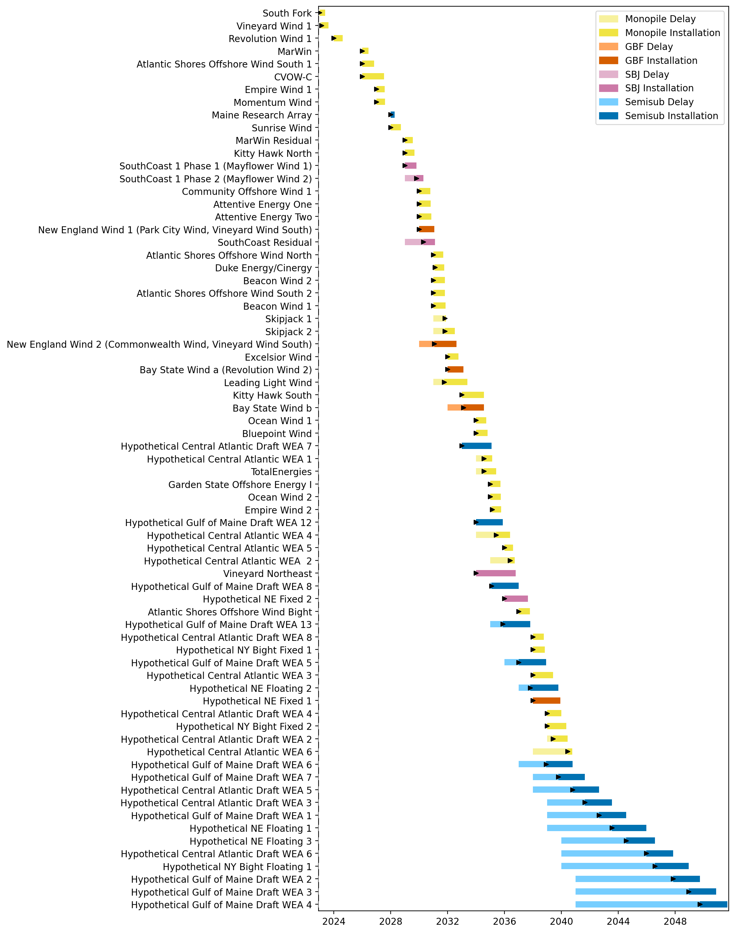
Full Gantt

Slide 9
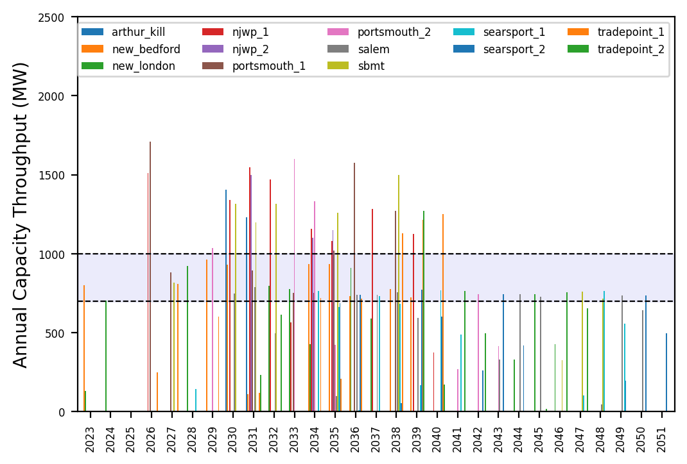
Port Throughput

Slide 10
Hybrid_Diff_Pipeline
t
e
x
t

Slide 11

Full Gantt

Slide 12
Port Throughput

Slide 13
3_WTIV
t
e
x
t

Slide 14
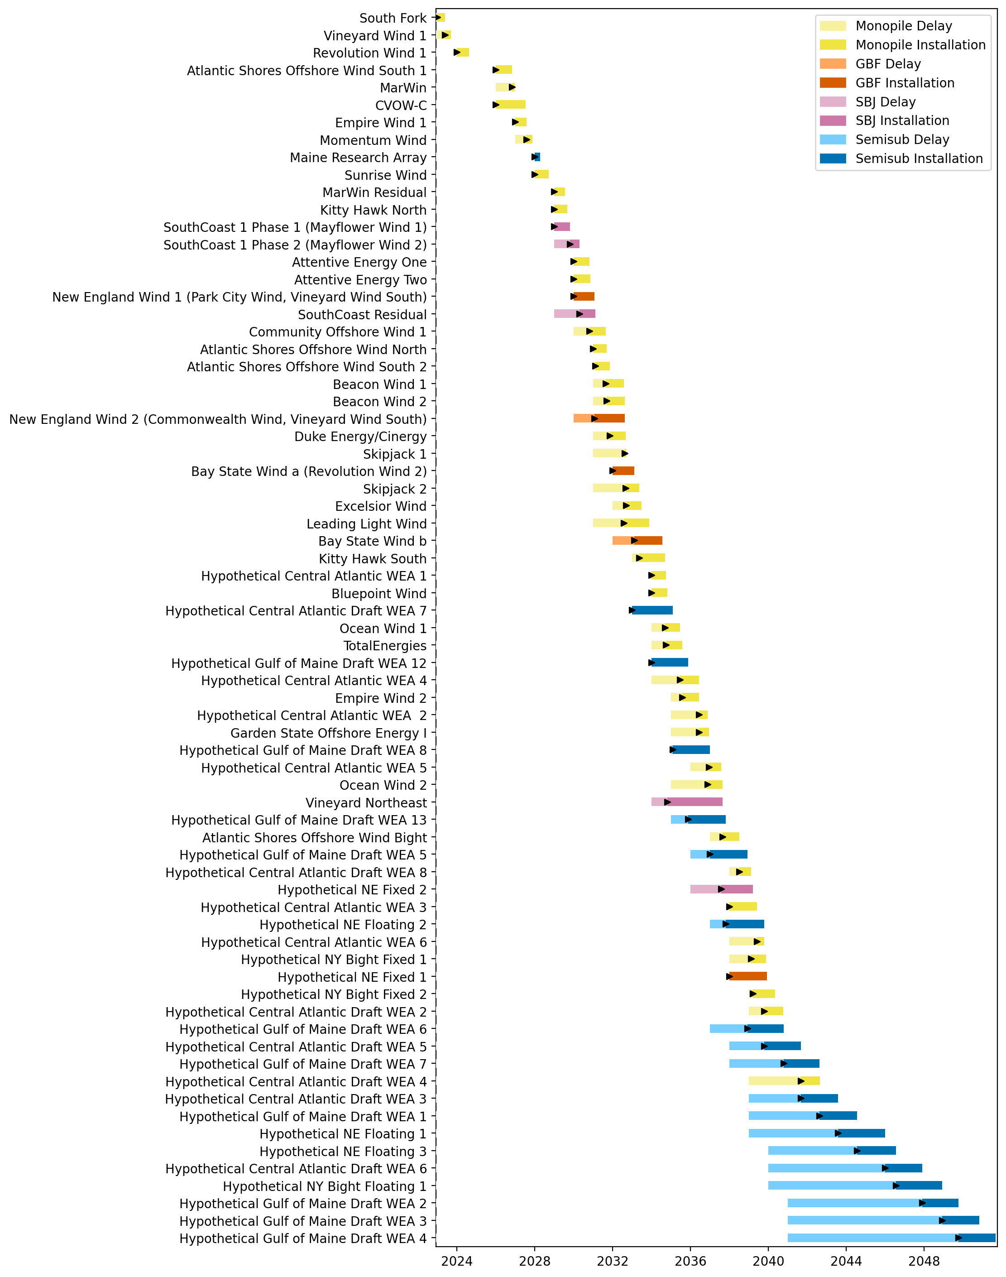
Full Gantt

Slide 15
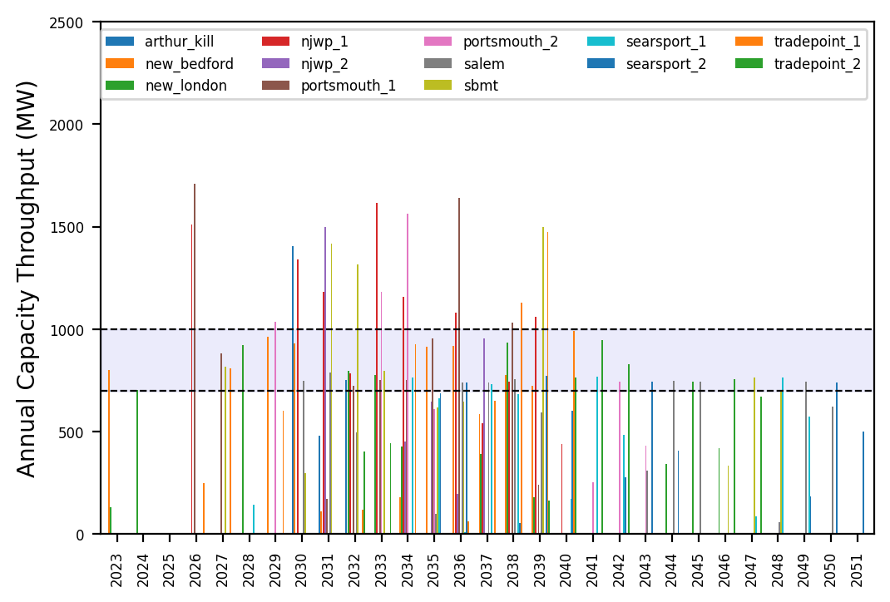
Port Throughput

Slide 16
Hybrid_3_WTIV_6_AHTS_6_Feeders_4_FFIV
t
e
x
t

Slide 17
Full Gantt

Slide 18
Port Throughput

Slide 19
6_AHTS
t
e
x
t

Slide 20
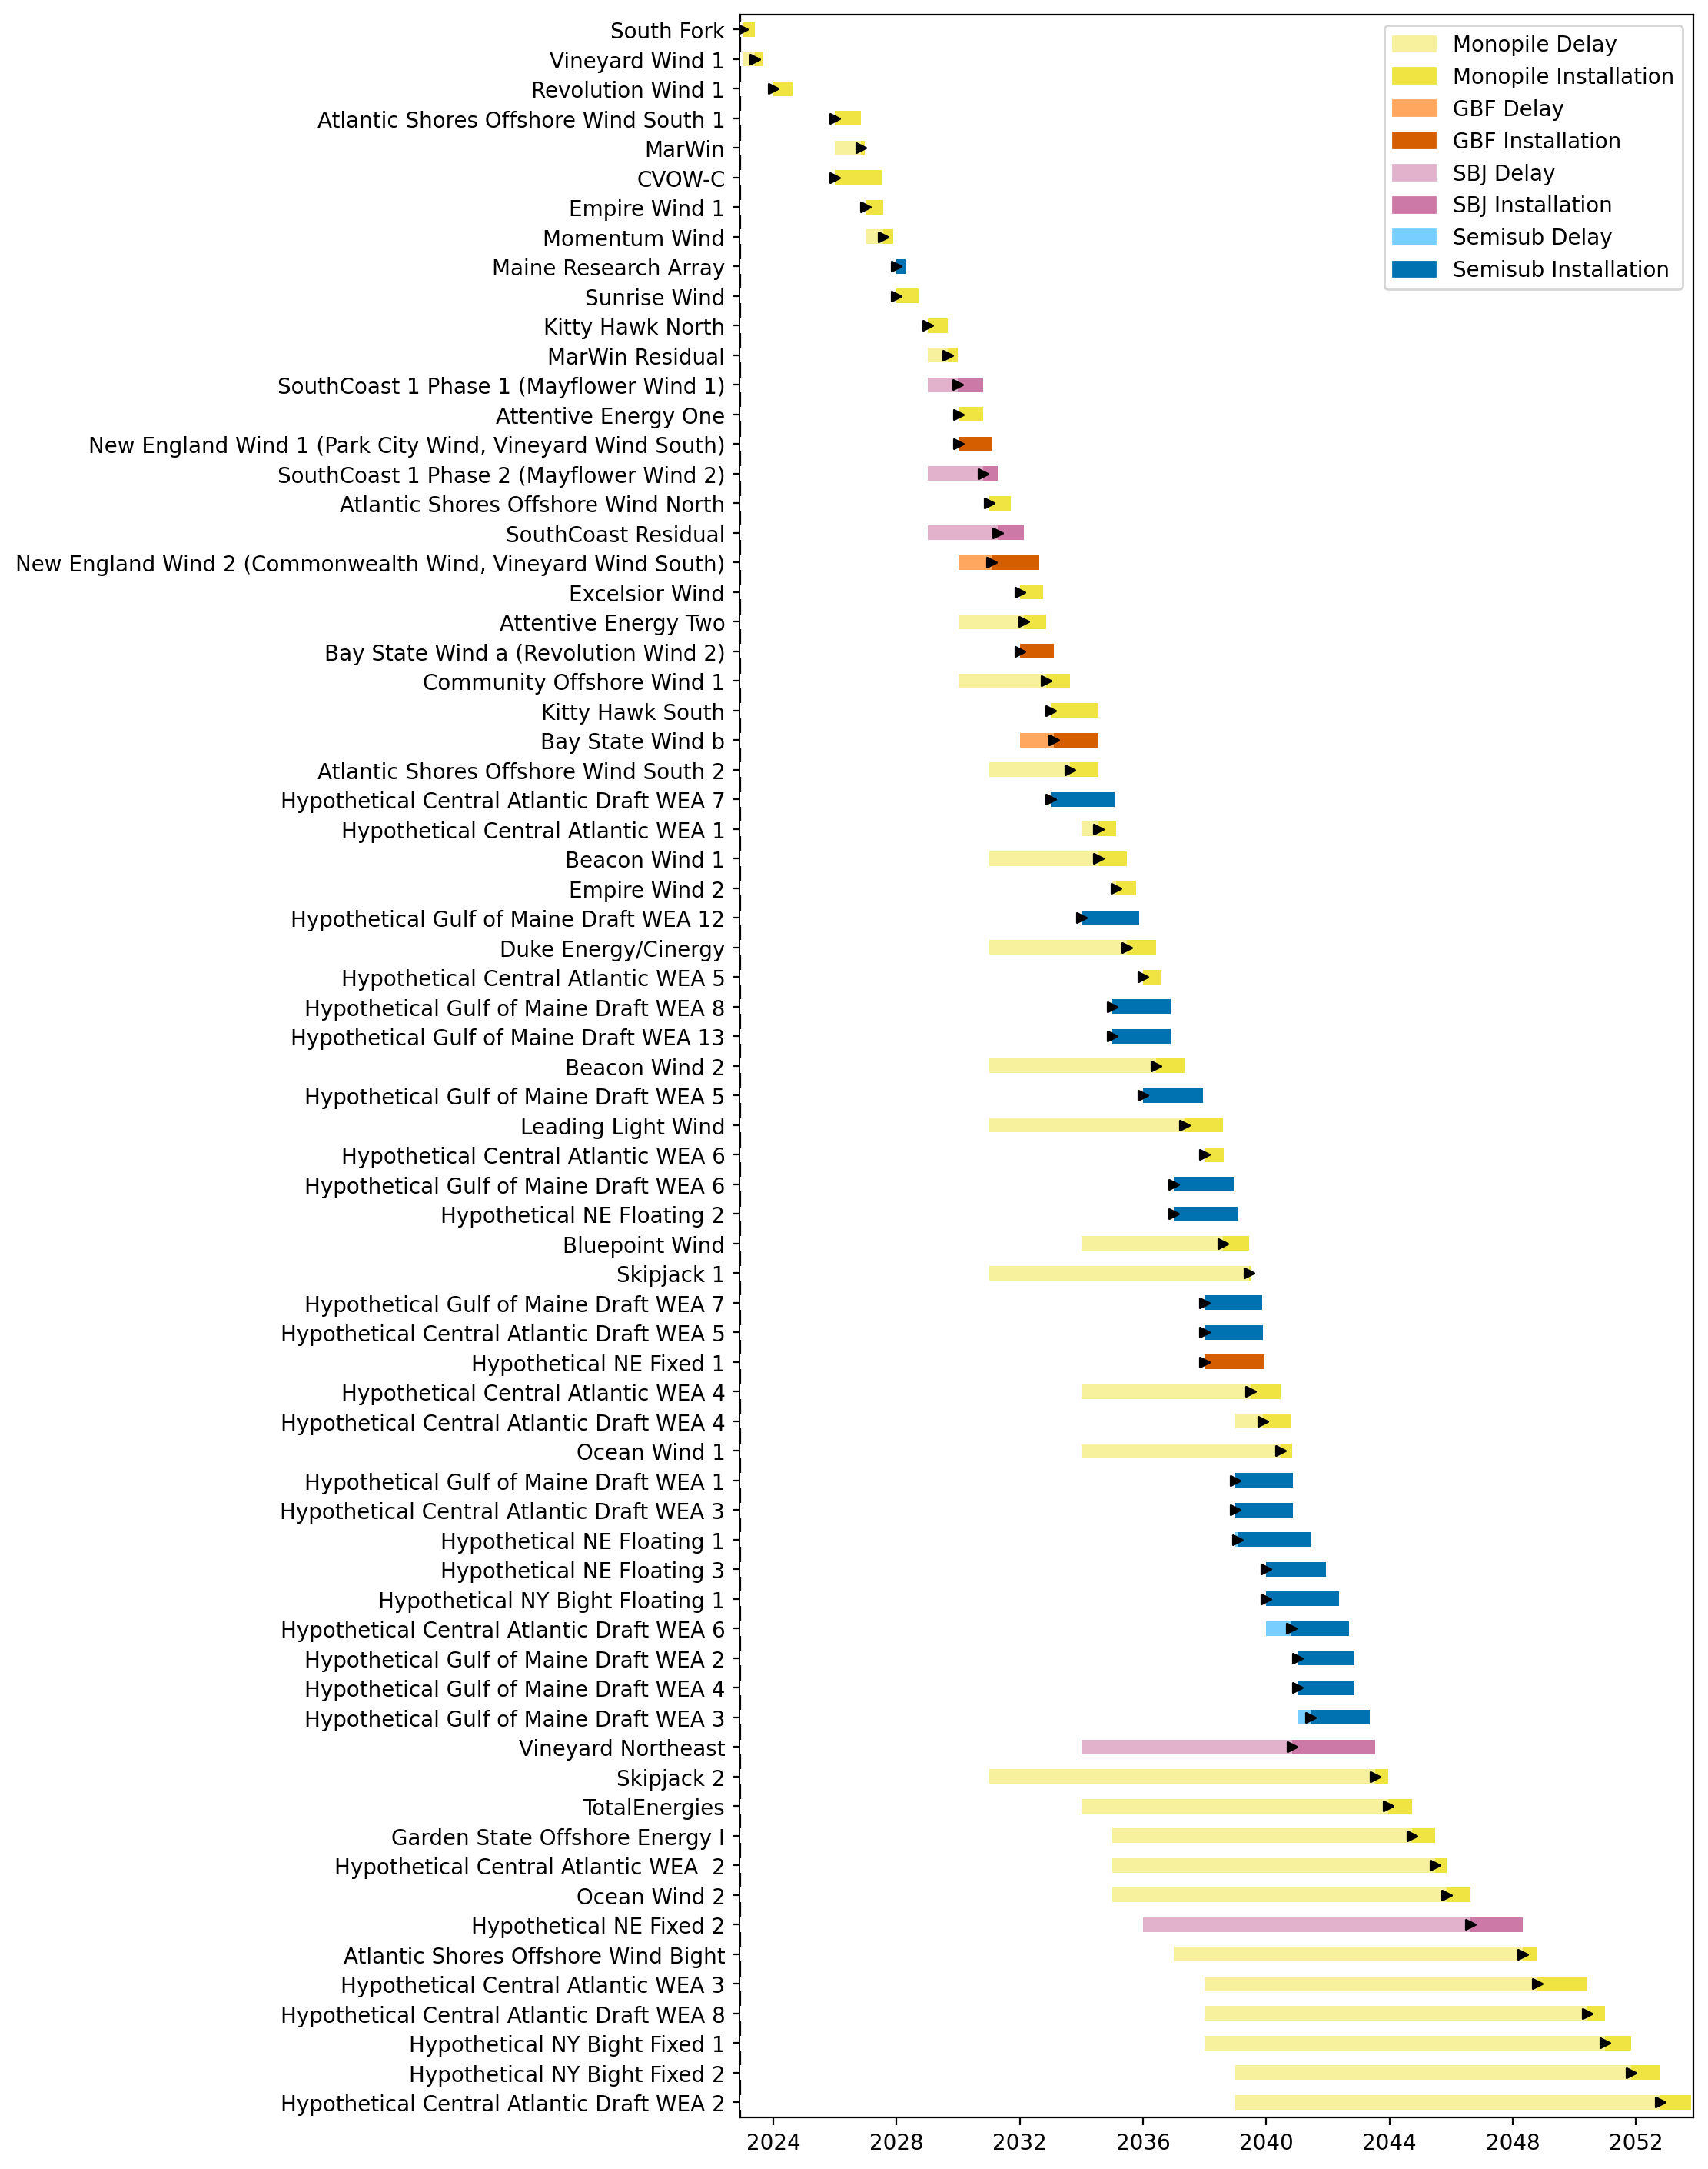
Full Gantt

Slide 21
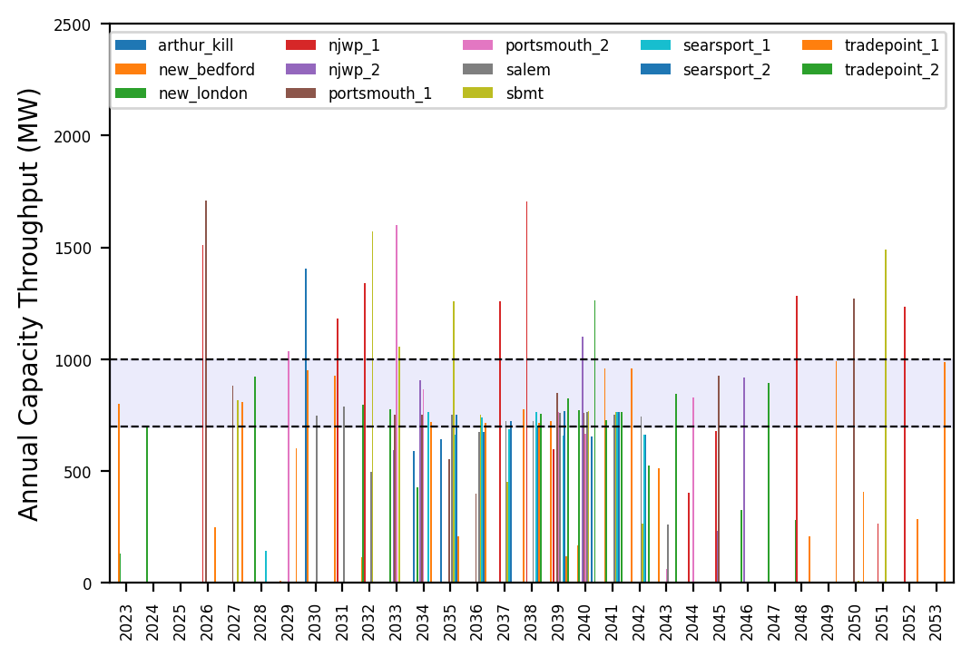
Port Throughput

Slide 22
no_action
t
e
x
t

Slide 23
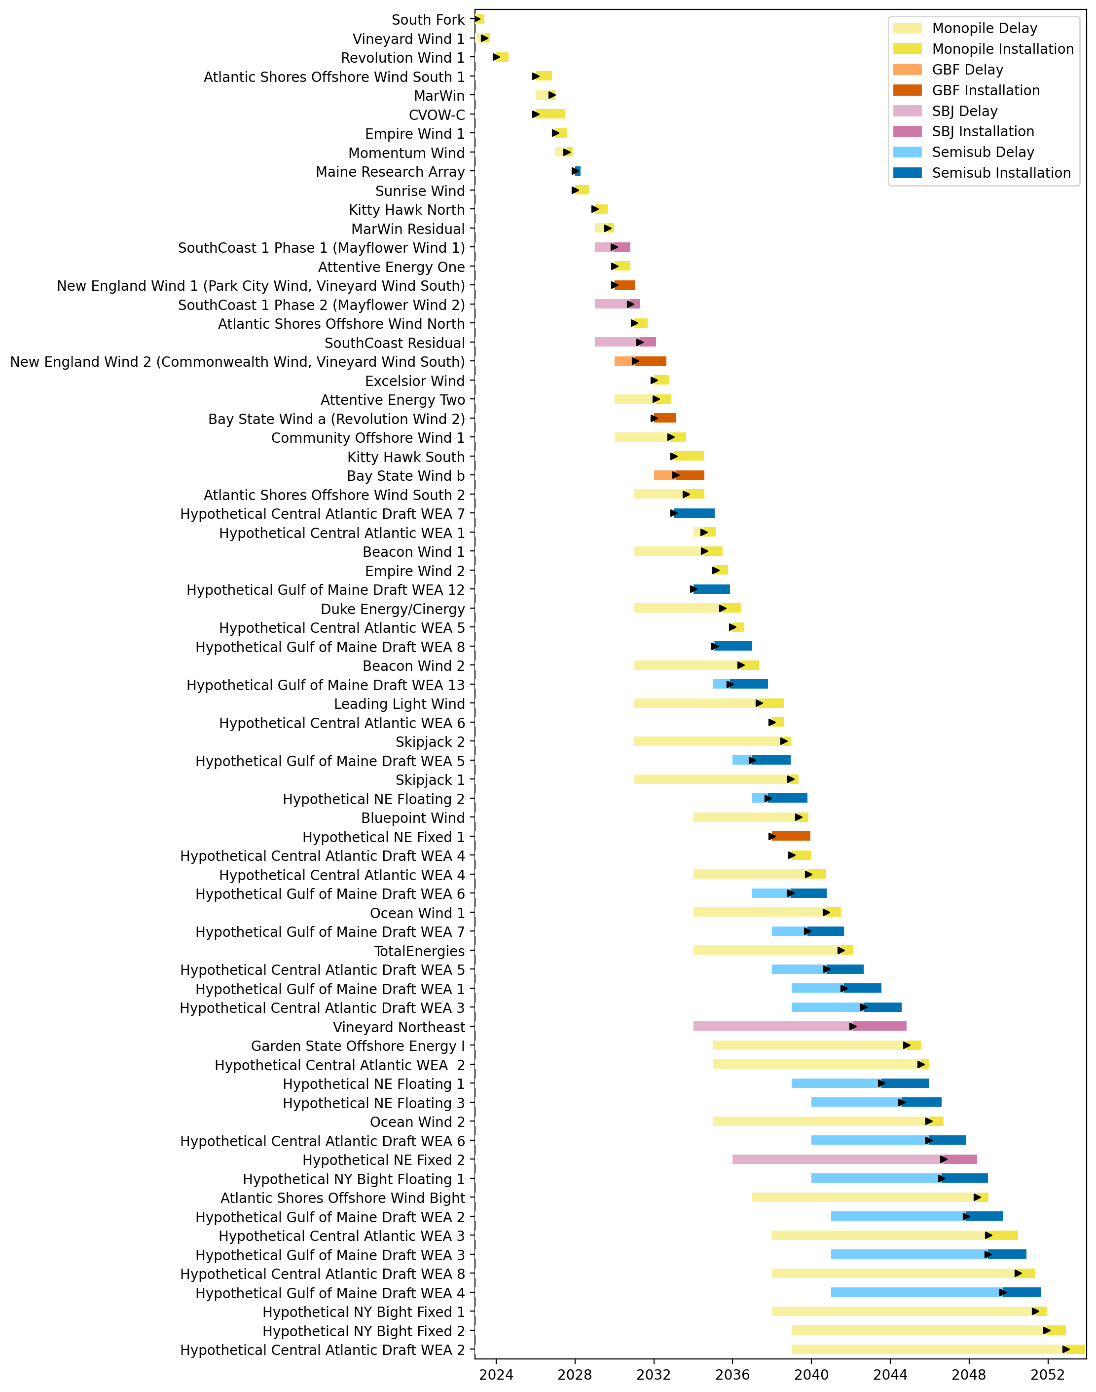
Full Gantt

Slide 24
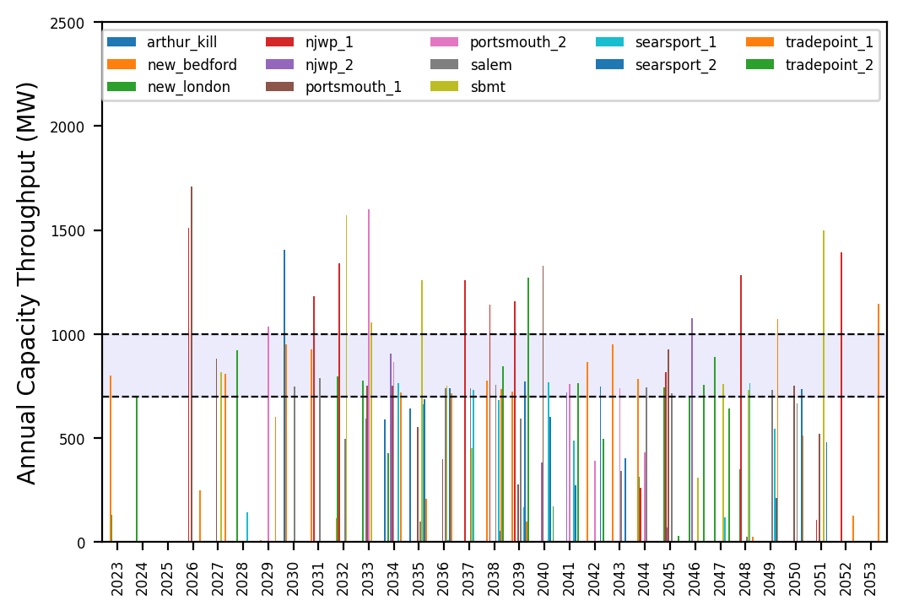
Port Throughput

Slide 25
natl_gaps_infv
t
e
x
t

Slide 26
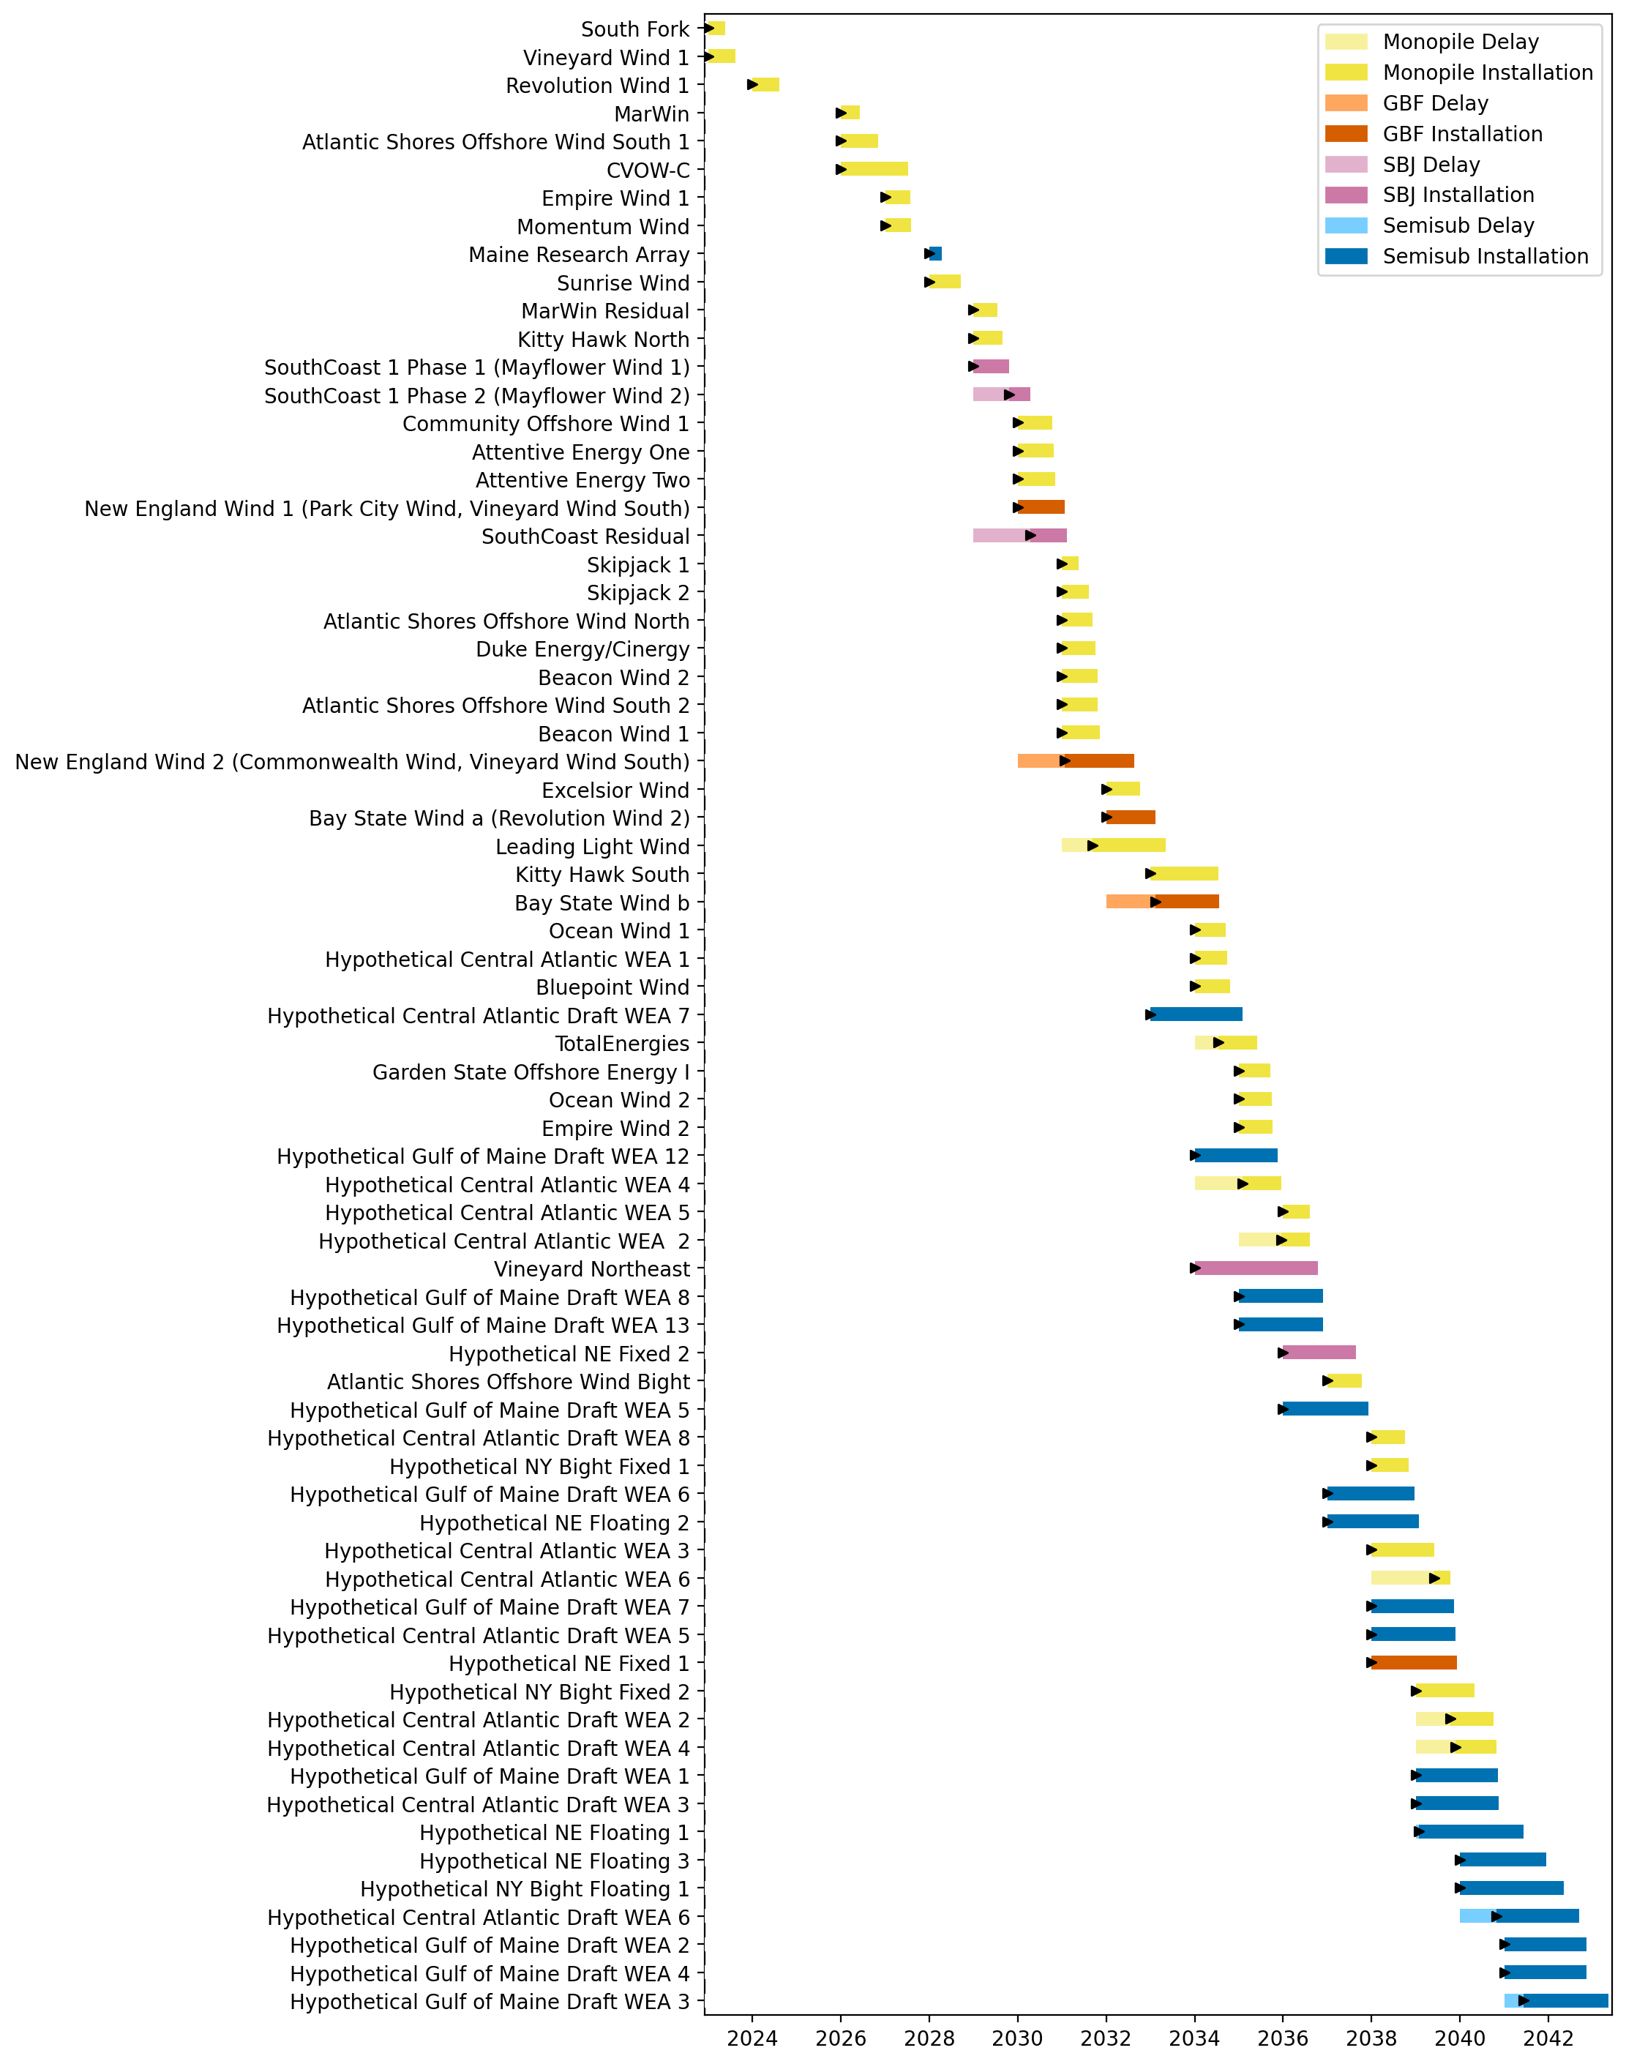
Full Gantt

Slide 27
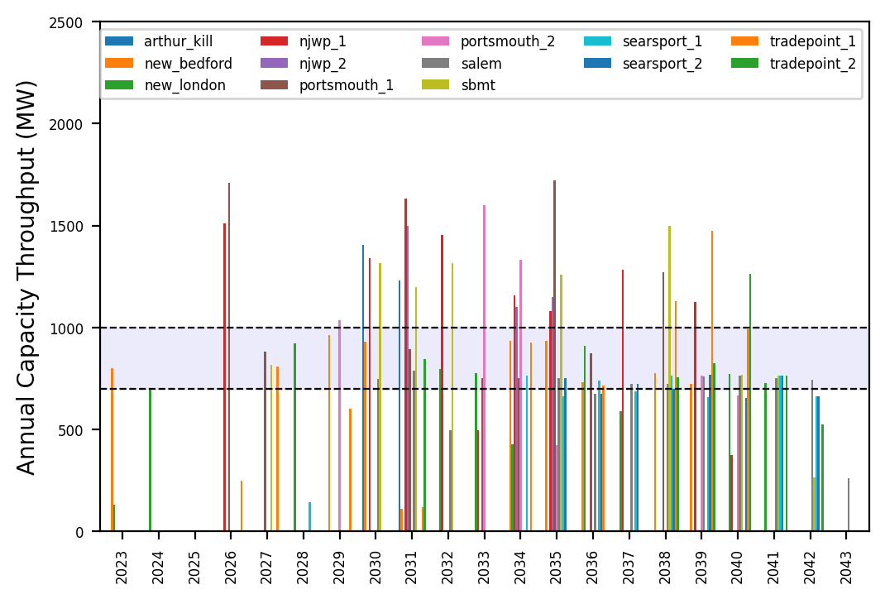
Port Throughput

Slide 28
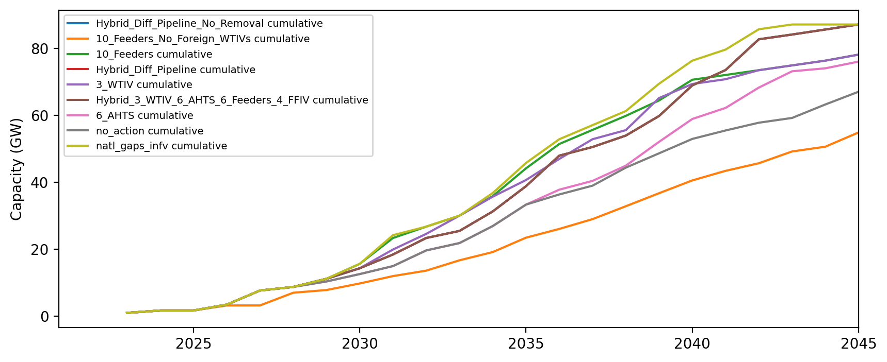
Installed Capacity

